Slide 1

Chinook Music Store
HARSH BHATIA
22/11/2024

Slide 2

INTRODUCTION
Chinook is renowned as a global leader in the physical music record industry.
Offers a diverse catalog of music, including classic hits and the latest releases.
Maintains a strong presence in key international markets through strategic service points.
Committed to delivering high-quality entertainment and a rich variety of music.
Actively expanding its reach and strengthening its position in the global market.

Slide 3
As a data analyst at Chinook, the primary objective is to Analyze music record sales data to uncover key trends and actionable insights.
By focusing on customer demographics, purchasing behavior, and churn rates to inform strategies.
Providing recommendations aimed at driving sustainable growth in the near-to-mid-term.
Enhancing understanding of customer preferences to improve retention and optimize sales.
Support Chinook’s efforts to strengthen its competitive position in the entertainment market.

Slide 4
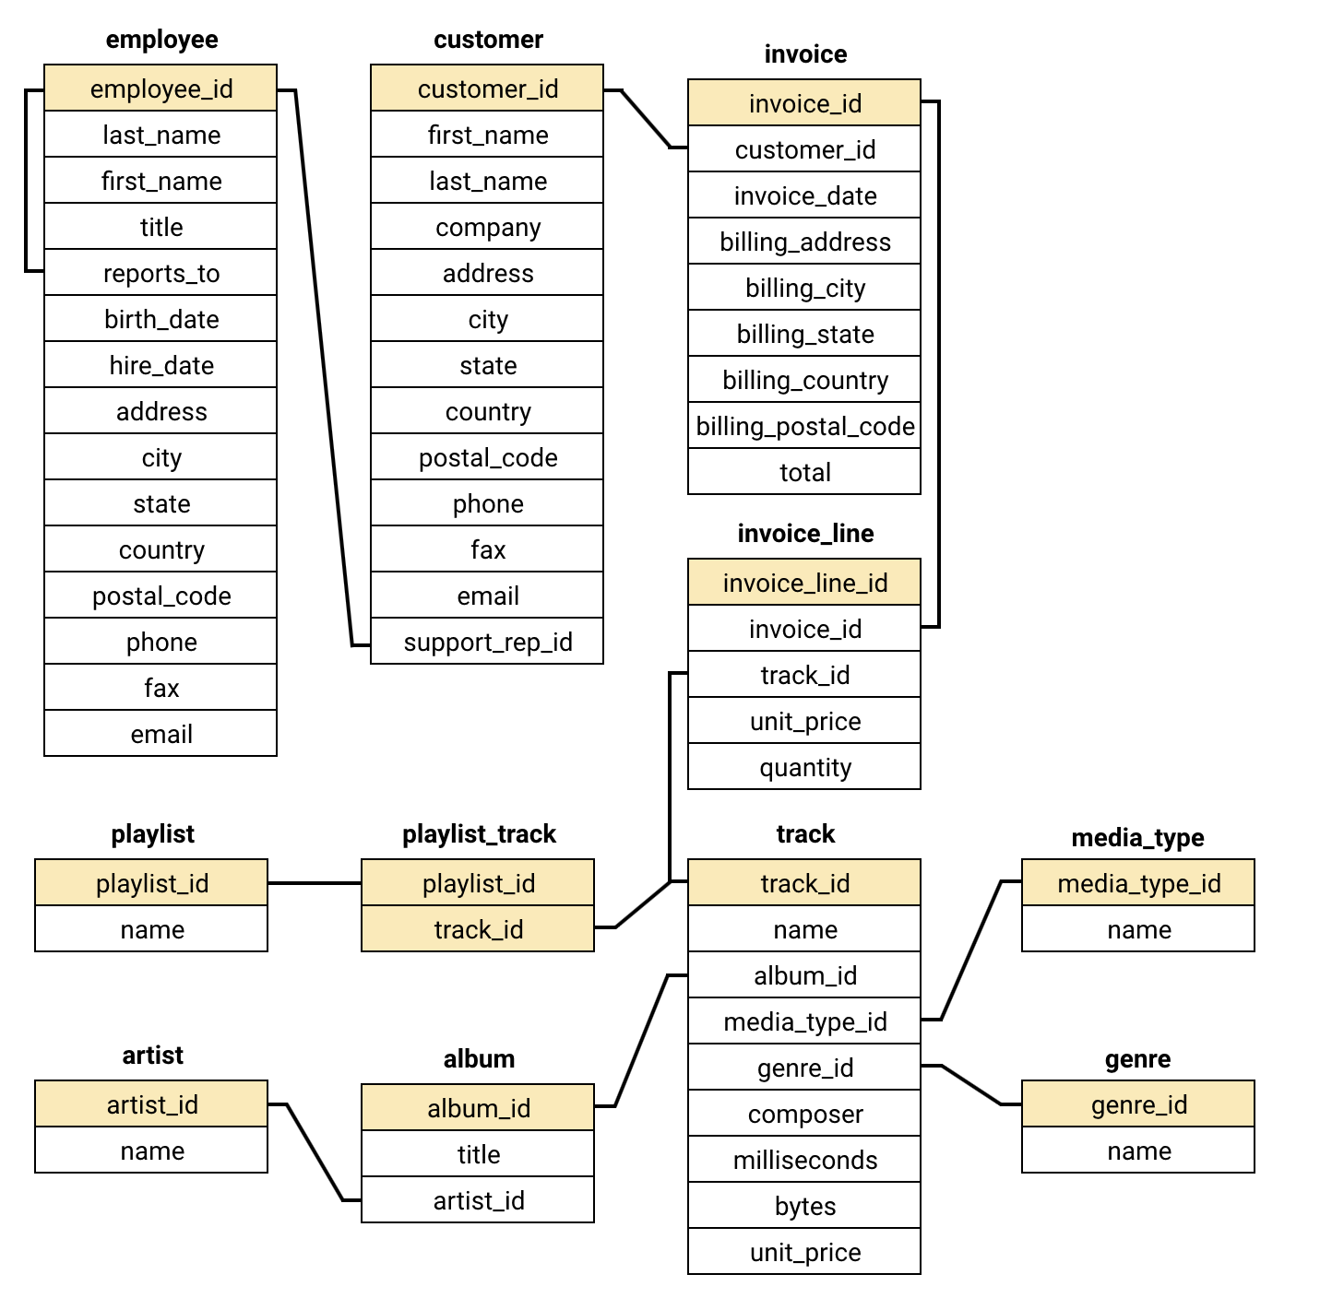
DATA OVERVIEW
Key Data Points:
Total Customers: 59
Total Countries: 24
Tracks: 3,503 tracks
Genres: 25
Artists: 275
Top revenue countries:
USA, Canada, Brazil.
Popular Genres: Rock, Metal, Alternative, Blues

Slide 5
METHODOLOGY
Handling Missing Values:
Customer Table:
Fax: Missing values filled with “Not Available” .
Postal Code: Missing values replaced with “N/A”.
Company & State: Filled with “Not Available”
Employees Table:
Reports To: Null value for the General Manager left unchanged, as it is logical and accurate.
Tracks Table:
Composer: Missing values replaced with “Not Available”.
Removing Duplicates:
Verified no duplicate records across all tables.

Slide 6
Top 10 Best-Selling Tracks in USA
Insights:
"War Pigs" by Cake leads sales in the USA.
Artists like Cake, Van Halen, and The Rolling Stones consistently appear in the top-selling tracks.

Slide 7
Customer Demographic Analysis
Insights:
USA has the highest customer count (13 customers), indicating a strong market presence.
Canada and Brazil rank second and third, respectively, with significant customer counts.
The top 10 countries account for a majority of the customer base, representing key markets for revenue generation.

Slide 8
Frequency of Purchases across the years
Insights:
High-activity months (January, February, August): Focus on marketing campaigns, discounts, or special releases during these periods.
Low-activity months (December, September, November): Consider targeted promotions or improving customer engagement during slower periods.

Slide 9
Monthly Average Order Value across the years
Insights:
Months with higher average values (June, October): Consider leveraging these successful periods with targeted promotions or upscale offerings.
Months with lower values (December, January): Assess why order values drop and consider introducing value-driven campaigns or bundled deals.

Slide 10
Customer Churn Rate
Insights:
There are total of 59 customers across all the countries.
Churn Rate: The churn rate is 27.12%, indicating that over a quarter of the customers have stopped purchasing in the given period.
Impact on Revenue: A high churn rate can significantly affect long-term revenue, as retaining existing customers is typically more cost-effective than acquiring new ones..
Recommendation:
Engagement Strategies: Introduce targeted email campaigns, loyalty programs, and exclusive offers to re-engage customers.
Customer Feedback: Collect feedback to understand reasons for churn and address any gaps in the customer experience.
Retention Focus: Prioritize high-value customers to prevent further revenue loss by offering tailored incentives.

Slide 11
Genre Sales Analysis in USA
Insights:
Rock is the top-selling genre, driven by artists like Van Halen, The Rolling Stones, and Nirvana.
Alternative & Punk and Metal also perform well, with contributions from bands like Green Day and Black Sabbath.
Prioritize Rock and Alternative & Punk for marketing and promotional efforts.
Launch promotional campaigns for underperforming genres to boost sales

Slide 12
Long-Term Customers vs Short-Term Customers
Insights:
Long-term customers spend more (28,034.82 vs. 19,468.35) and purchase more items (2,762 vs. 1,995).
Short-term customers outnumber long-term ones (32 vs. 27), highlighting a need to boost conversions.
Long-term customers show higher engagement and value, making retention a key revenue driver.
Targeted marketing is essential to engage short-term customers and convert them into loyal patrons.

Slide 13
Customer Lifetime Value Modelling
Insights:
High-Value Customers spend more (80.80 average) with 10.53 orders, compared to Regular Customers (51.98 average, 7 orders).
Regular Customers show growth potential and can be converted into high-value customers with targeted marketing.
Focus retention efforts on High-Value Customers using loyalty programs, personalized incentives, and exclusive offers.
Implement targeted campaigns to increase engagement and spending among Regular Customers.
Address churn proactively by re-engaging high-value churned customers with tailored offers and promotions.

Slide 14

Recommendation
Prioritize High-Value Customers: Retain high-value customers with loyalty programs, personalized offers, and exclusive deals to maximize revenue and prevent churn.
Convert Short-Term to Long-Term Customers: Engage short-term customers with targeted campaigns offering discounts, personalized recommendations, and incentives to drive repeat purchases.
Promote High-Selling Genres & Artists: Focus marketing on Rock, Alternative & Punk, and Metal genres, highlighting popular artists like Van Halen and The Rolling Stones.
Expand in High-Opportunity Markets: Strengthen efforts in key markets (USA, Canada, Brazil) and explore growth in emerging markets (France, Germany) through tailored strategies.

Slide 15

Enhance Customer Retention: Address 27.12% churn with re-engagement campaigns, improved services, and loyalty rewards.
Leverage Temporal Trends: Target peak months (January, February, August) with promotions and address dips (December, November) with special campaigns.
Target Genre-Specific Campaigns: Create niche campaigns for underperforming genres like Classical and Soundtracks to engage new customer segments.
Monitor Customer Lifetime Value (CLV): Use CLV to segment customers, re-engage high-value/churned customers, and nurture regular ones for growth.

Slide 16
Conclusion
Customer behavior, sales trends, and market performance highlight key areas for growth and operational optimization.
Strategic priorities include retaining high-value customers, converting short-term buyers, and emphasizing top-performing genres and artists.
Addressing churn and enhancing retention strategies will improve loyalty and lifetime value.
Opportunities exist to expand in high-performing and emerging markets with region-specific campaigns.
Data-driven strategies ensure alignment with customer behaviors and preferences.
Implement personalized marketing, enhanced loyalty programs, and seasonal/genre-focused promotions for sustainable success.

